Slide 1
VMware Cloud on AWS Technical Deck
Brian Graf
Senior Technical Marketing Manager
VMware Cloud on AWS
Notes:
M5 Technical Deck (12-2018)

Slide 2
CLOUD BUILDING CHALLENGES
Operational Consistency
Existing Skillsets & Tools
Control, Manage, Secure
Enterprise-class App SLA
Compatibility with Apps
Notes:
Migrating workloads is not as easy as some people say it is.
You're dealing with Multiple VM formats.
Its not a matter of converting a vmdk into a AWS AMI file,
but its all about operational consistency and trying to leverage skillsets and tools.
Provisioning is typically different in public clouds than on-prem datacenter.
Toolsets are inconsistent between on-prem and public cloud
Think about the skillset needed to manage the migration process and day-to-day operations.
Think about the different security baselines.
How are you going to secure your applications in public cloud and what tool sets are used for identity management?
But the big kicker is that traditional applications are running in enterprises are typically state-full applications.
Running on a resilient infrastructure, which leverages HA, DRS and all that other goodness offered by vSphere
Now compare this to the public cloud and you will get a very different set of sla’s from the infrastructure point of view.
It’s almost like a invisible infrastructure,
you have to rebuild your application to becomes stateless and incorporate resiliency
within the application cause the infrastructure is expected to fail without any guarantee that data is available.
Services like auto-scaling and automatic load-balancing are at your disposal,
but we see a lot of customer struggle with refactoring their application to leverage these services
Or transforming the application architecture to get it working in the cloud.

Slide 3

INTRODUCING TWO POWERFUL FORCES COMING TOGETHER
Notes:
We thought long and hard about it and decided that if we partner with Amazon we can solve most of these challenges. AWS is a renowned datacenter operator. It knows how to operate at scale and has a global reach. Couple that with VMware and you can start to build scalable cloud solutions anywhere in the world with your current skillset and your current tool-set.

Slide 4
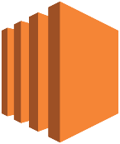





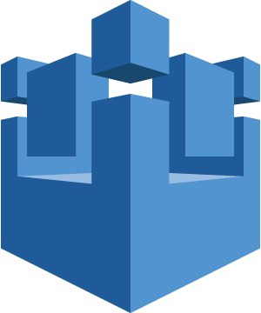
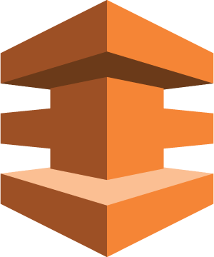

VMware Cloud on AWS
vRealize Suite, vSphere Integrated Containers, ISV Ecosystem
Operational Management
VMware Cloud™ on AWS Powered by VMware Cloud Foundation
Native AWS Services
…
…
vCenter
vCenter
Amazon EC2
Amazon S3
Amazon RDS
vSphere
vSAN
NSX
…
…
ESXi on Dedicated Hardware
Support for VMs and Containers
vSAN on Flash and EBS Storage
Replication and DR Orchestration
NSX Spanning on-premises and Cloud
Advanced Networking & Security Services
AWS IoT
AWS Direct Connect
AWS IAM
Customer Data Center
AWS Global Infrastructure
AWS Global Infrastructure
AWS Global Infrastructure
Notes:
VMware Cloud on AWS is powered by VMware Cloud Foundation, a unified SDDC platform that integrates vSphere, vSAN and NSX, and provides access to the broad range of AWS services, together with the functionality, elasticity, and security customers have come to expect from the AWS Cloud.
VMC leverages the bare metal cloud services from AWS. These dedicated bare metal servers provided the basis of the vSphere Software Defined Datacenter.
vSphere 6.5 allows customers to operate their Virtual Machines and Containers, similar to how they do it on-prem. It provides the platform for vSAN and NSX. All-Flash vSAN acts as the storage platform and consumes host-local NVMe flash devices. NSX is used for all network functionality. It connects the ESXi host to the AWS network and exposes logical networks for virtual machine networking.
vCenter is used to manage the SDDC. Allowing customers to operate this cloud platform with the current tool and skill set.
An in-cloud SDDC can be used on its own, but most customers have a hybrid cloud strategy. With vCenter Hybrid Linked Mode (a new feature for VMC), you connect the two vCenters to create a single pane of glass for Hybrid Cloud Management.
Most customers run a vRealize product on-premises such as vRealize Operations, or vRealize Automation. The in-cloud vCenter is just another end-point. You can continue using your existing on-premises vRealize producs,. This way, you get to manage both your on-premises SDDC and the VMC SDDC on a single pane of glass for operations and provisioning.
VMC provides access to the broad range of AWS services. It helps with data gravity. You are now able to place the application closer to the AWS services acting as data source.
Instead of network traffic egressing the DC firewalls to get to AWS, they are now connected to the same network as the underlying AWS services. This enables you to build and operate new application architectures

Slide 5
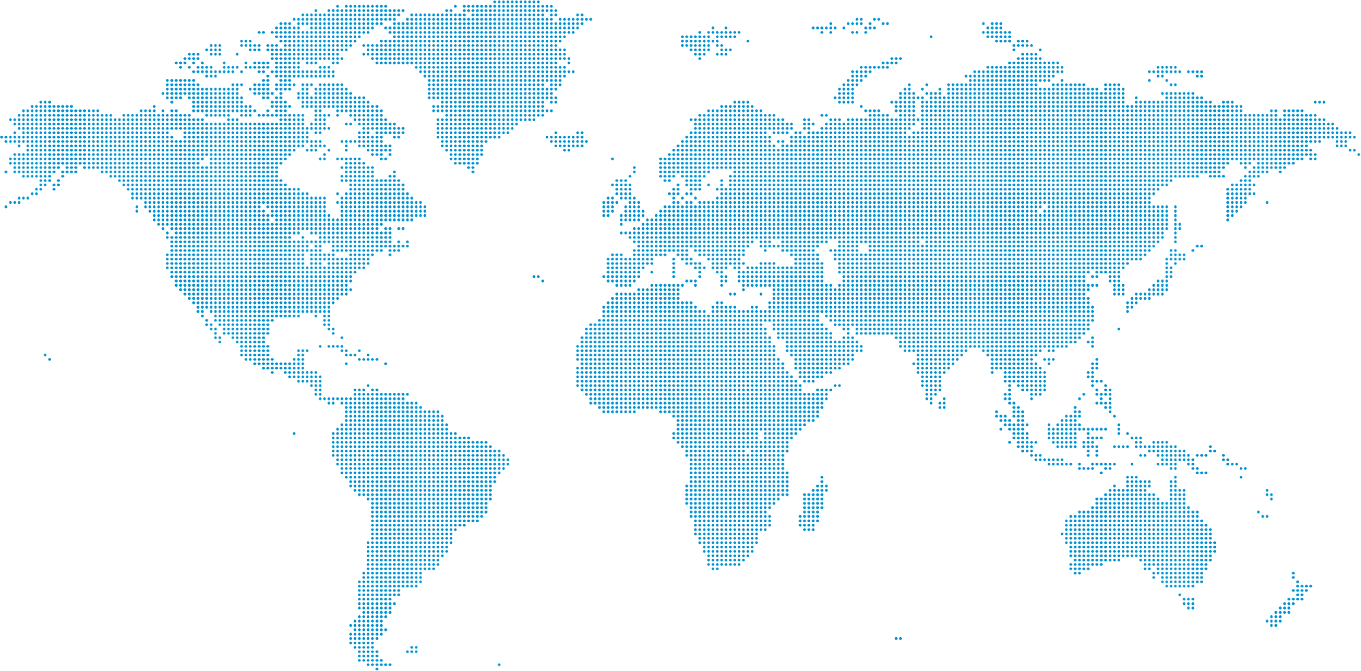
5
Simultaneously Expanding to Multiple Global AWS Regions
3
3
3
3
3
3
2
3
3
3
3
3
2
2
2
3
2
#
Available Regions and # of Availability Zones (AZs)
US West (Oregon)
US East (N. Virginia)
Europe (London)
Europe (Frankfurt)
Asia Pacific (Sydney)
Europe (Ireland)
*US West (N. California)*
US East (Ohio)
Asia Pacific (Tokyo)
Gov Cloud US West
3
2
3
March 2019 | Q2 2019 | Q3 2019 | Q4 2019 | 1H2020 (est.)
Asia Pacific (Singapore) | *South America (Sao Paulo)* | Europe (Sweden) | Bahrain | China (Mainland)
*Canada (Central)* | *Asia Pacific (Seoul)* | China (Hong Kong) | Gov Cloud US East | Cape Town
Europe (Paris) | **Asia Pacific (Osaka-Local)** |  |  | Milan
 | *Asia Pacific (Mumbai)*
#
#
#
#
* Stretched cluster not supported (2 AZs)
** Disaster Recovery site only, gated entry
Notes:
We listen to our customers and partners – you have told us to bring Vmware Cloud on AWS to you where your business operates. We have worked hard on this jointly with AWS and are excited to share the global roll out path for Vmware Cloud on AWS – accelerating from one region a quarter to multiple regions a quarter.

Slide 6
Run Your Workloads Anywhere
Scenario 1:
Maintain and Expand
Scenario 2:
Consolidate and Migrate
Scenario 3:
Workload Flexibility
Maintain
Expand
Consolidate
Migrate
Flex as needed
Private Cloud
Public Cloud
Private Cloud
Public Cloud
Private Cloud
Customer Has the Choice to Run Workloads Across On-Premises DC and Cloud
Running VMware Cloud on AWS Gives You
Ultimate Cloud Flexibility and Freedom
Notes:
From speaking with customers, agility is one of the main drivers to adopting cloud.
Private, public or a combination of the two – a hybrid environment.
We see many different ways customers are looking to leverage a hybrid cloud environment.
Some customers really plan to keep their center of mass in their private cloud, but selectively looking to extend to Public for things like DR or Geo Capacity Expansion.
Other customers want to reduce their datacenter footprint and run more workloads in the Public Cloud, sometimes migrating apps selectively, in other cases, pursuing the datacenter zero model and they want to get out of managing datacenters completely.
Finally, we see other customers who want to treat their Private Cloud and Public Cloud as equal peers, and easily move workloads between them, for things like moving apps from Dev/Test to Production or Burst Capacity.

Slide 7
Cloud SDDC

Slide 8
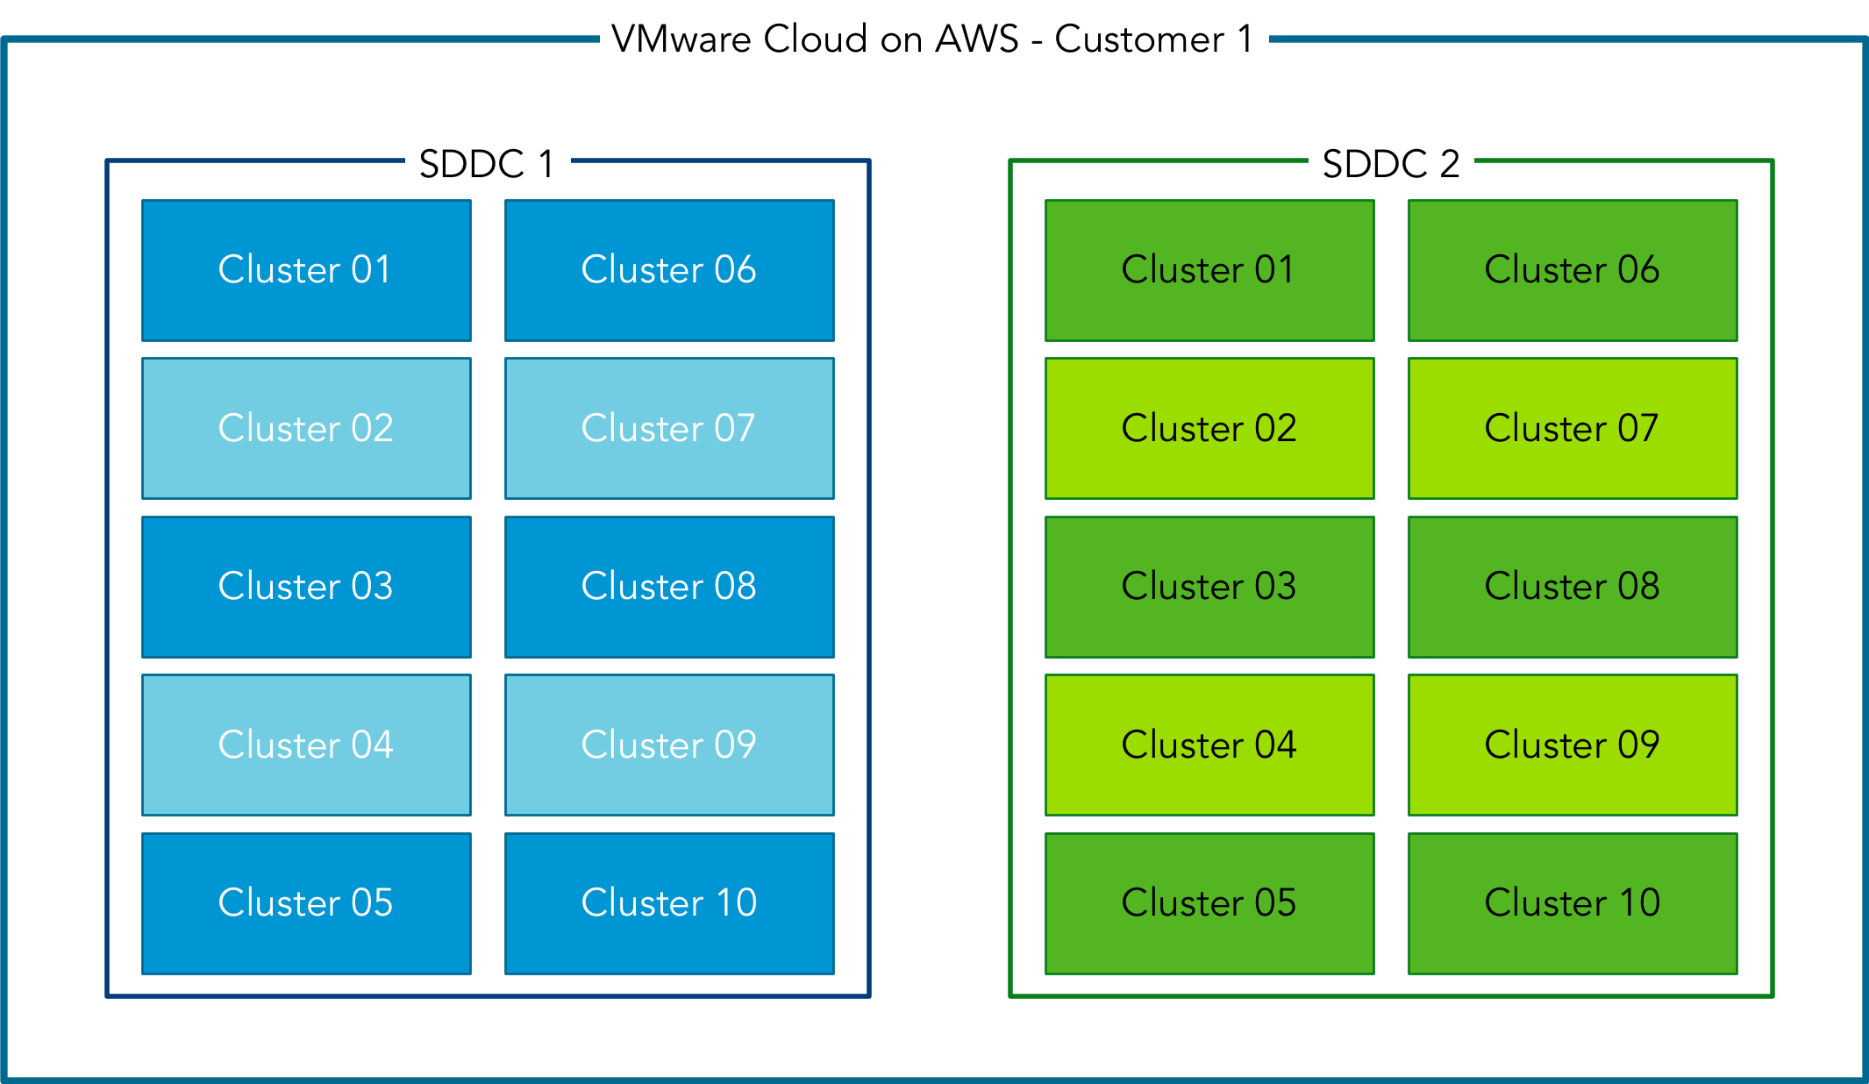
Cloud SDDC Configurations
Up to 10 SDDCs supported per Organization
Up to 20 vSphere clusters per SDDC
Up to 16 hosts per cluster
Only Cluster-01 has management workloads. Every additional cluster is 100% for customer workloads
Notes:
Each SDDC can support up to 10 individual clusters with a minimum of 3 hosts per cluster. The initial cluster contains the management VMs while all other clusters are fully available for customer workloads.

Slide 9
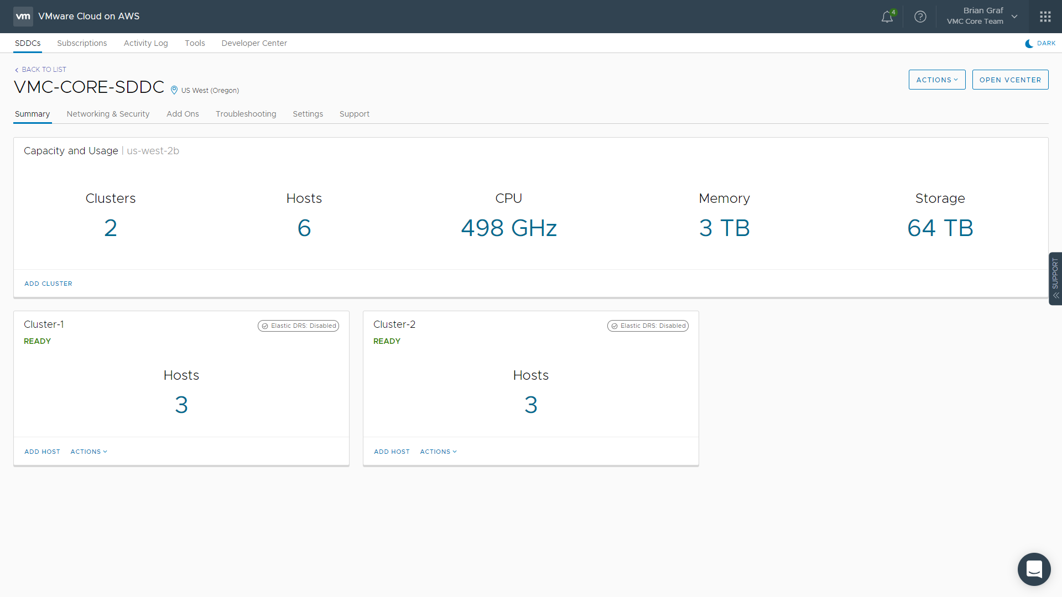
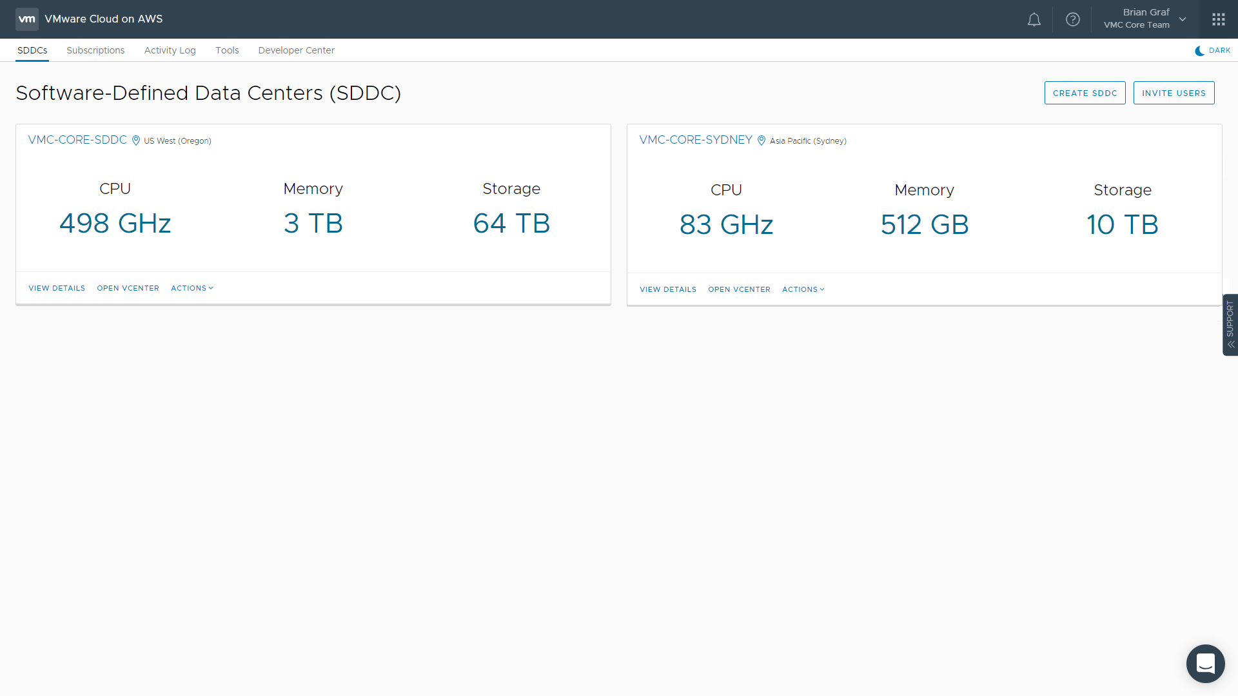
Multi SDDC & Multi Cluster Portal View
Notes:
Each organization (logical construct allowing co-workers and teams access to the same resources) can support multiple SDDCs. You can also see what the Summary page of an SDDC looks like that has multiple clusters.

Slide 10
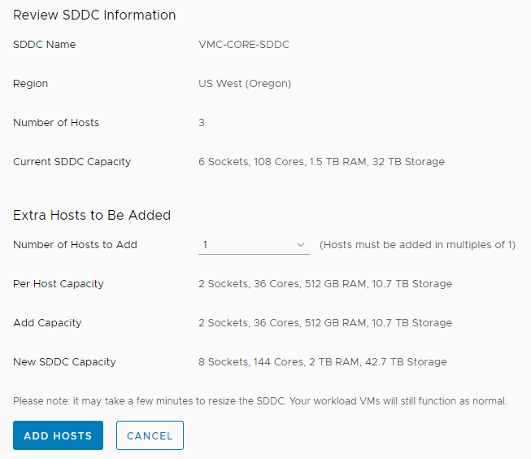
Cluster Expansion & Contraction: Customer
Motivation
Flexibly expand and contract cluster within minutes
Overview
Customer can specify number of hosts to add or remove to/from their cluster
Hosts are added within minutes
Hosts removed from the cluster are evacuated of VMs and data prior to their removal completing
Notes:
One of the great benefits of using VMware Cloud on AWS is the ability to quickly and easily add and remove hosts from your SDDC. Hosts are pulled from AWS’s pool of servers. ESXi is booted and configured, then added to your vCenter/SDDC. This whole process takes about 10 minutes.

Slide 11
vSphere Cluster Configuration

Slide 12
Compute Cluster Configuration
CORES
CORES
108
576
Four host base cluster configuration
Can be expanded up to 16 hosts
Dual socket CPU host configuration
Intel E5-2686 v4
18 Cores per socket at 2.3 GHz
Hyper-Threading is disabled by default
512 GiB memory per host
TO
3 NODE CLUSTER
16 NODE CLUSTER
1536
8192
TO
GiB
GiB
Notes:
The base cluster configuration of VMC starts with three hosts. The cluster can be expanded up to 16 hosts.
Each host is configured with 512 Gigabytes of memory and contains two CPU sockets.
Each socket is populated by a custom-built Intel Xeon E5-2686 v4 (broadwell) CPU package that contains 18 cores.
Each core runs at 2.3 GHz. This results in a cluster core count of 144 Cores. This is the physical core count. Hyper-threading is disabled currently in light of the Intel exploits found in 2018.
A base cluster contains 1.5 Terabytes of memory.
VMC is based on the scale-out model. It allows for scaling-out to 16 hosts.
If the cluster contains 16 host, 576 CPU cores will be available for consumption and in total 8 TB of memory is available.

Slide 13
vSphere DRS Configuration
DRS Enabled
Migration threshold = 3
DPM = Disabled
Resource Pools created to isolate MGMT from customer VMs
Affinity Rules via Compute Policy
VMware
Customer Administrator
(Cloud Admin)
VC
NSX
…
VM
VM
VM
VM
VM
Managed by VMware
Managed by Customer
vSAN Cluster
Notes:
The DRS cluster configuration is set by VMware and use a default configuration.
The Migration threshold is set to level 3 (default) to avoid excessive vMotion operations. Two resource pools are created: one for customer workloads, and one for the management VMs
Customers can create child resource pools within this resource pool if they desire this.
The resource pool that contains the management VMs is managed by VMware. Customers have read-only access to these objects

Slide 14
Automatic Cluster Configuration
1.
2.
AUTOMATIC NETWORK CONFIGURATION
3.
vSAN DATASTORE CAPACITY INCREASE
HOST IS ADDED
vSAN Cluster
vSAN Cluster
vSAN Cluster
Management Network
vMotion Network
vSAN Network
VXLAN Network
Notes:
The Elastic Cluster takes care of all the host configuration automatically.
When a host is added to the cluster, VMC configures every VMkernel and logical network automatically.
After the host is connected to the network and added to the cluster, the vSAN Datastore is automatically expanded, allowing the cluster to consume the new storage capacity and begin to sync the vSAN objects.

Slide 15
Automated Hardware Remediation
Roadmap
1.
HOST FAILS, OR PROBLEM IDENTIFIED
vSAN Cluster
2.
NEW HOST ADDED TO CLUSTER.
DATA FROM PROBLEM HOST REBUILT, AND/OR MIGRATED
vSAN Cluster
3.
PREVIOUS HOST EVACUATED FROM CLUSTER, FULLY REPLACED BY NEW HOST
vSAN Cluster
Notes:
The same fleet management framework is used for automated hardware remediation. Short-term host outages such as a Purple Screen of Death (PSOD) are usually absorbed by the remaining hosts, VMs are restarted on other hosts but the VMs might have a reduced amount of resources available to them.
But if the host fails indefinitely, resource management problems occur.
In an on-premises environment, the IT org would need to order, rack and stack, and configure the new servers when they finally arrive. On average this process takes 6 to 9 months. During this time SLAs could be breached.
Some customers over provision their clusters to avoid long-term resource availability, but not every customer likes the economics of this design.
VMware Cloud on AWS avoids long-term resource depletion by automatically adding a host if the host fails or a component is degraded. For example, an entire host failure or flash device failure.
A new host is automatically provisioned, configured and added to the cluster without human interaction. The failed host is removed from the cluster as long as it does not violate VSAN FTM policy.

Slide 16
HA Cluster Configuration
Host failure remediation is the responsibility of VMware.
As HA settings impact consolidation ratio, the following settings are used to provide excellent service while minimizing overhead:
Host Monitoring Enabled
Admission Control Policy: Percentage Based
Host Failures Tolerate: 1
VM & App Monitoring Enabled
Host Isolation Response: Power off and Restart VMs
Notes:
Host failure remediation is the responsibility of VMware,
The default HA settings are applied to the SDDC cluster, providing the best balance between economics and availability.

Slide 17
Custom CPU Core Counts
Regular Cluster
“Custom” Cluster
Increased deployment flexibility
Specify just the number of CPU cores you need per host (applied cluster wide)
Reduce costs for running mission-critical applications licensed per-core
…
…
Notes:
Generally, for licensing purposes, a customer may want a smaller cluster in terms of CPU cores. That being said, customers can create additional clusters in VMware Cloud on AWS and specify the number of cores they want active in that cluster.
When the cluster is brought up and hosts are added, each of these hosts has the specified cores turned on and all the rest are turned off at the BIOS level, meaning, they are not even recognized by the host once it has booted up.
A minimum of 3 hosts is still required, and customers still pay for the entire host, however, the customer would not have to pay to license all the additional cores which are turned off.

Slide 18
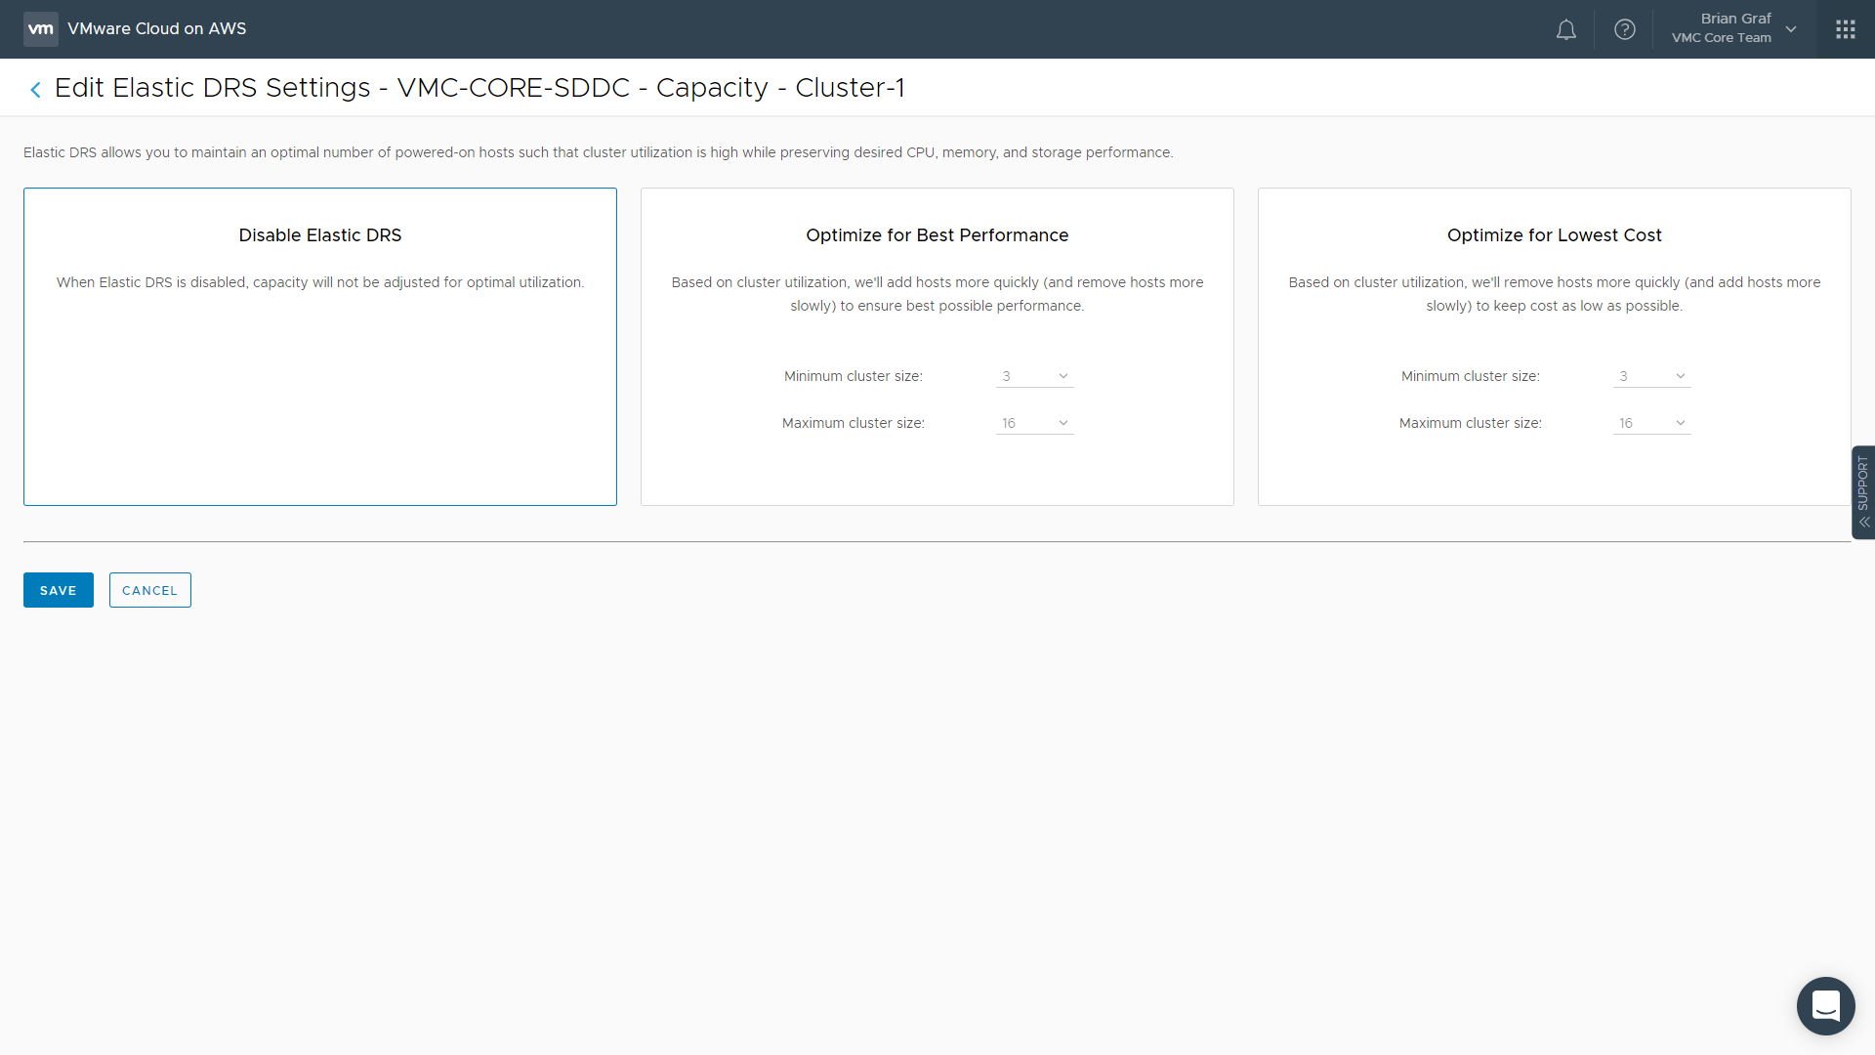
Elastic DRS
Scaling Hosts For On-Demand Requirements
Notes:
Elastic DRS gives flexibility to customers to allow the service to add additional hosts to an SDDC if resource utilization begins to increase above specific thresholds, thereby placing customer workload performance at risk. By enabling Elastic DRS, customers can choose to: Optimize for Best Performance: VMC will be quicker to add hosts to satisfy resource utilization and performance, and slower to remove the host to ensure VMs stay performant
Optimize for Lower Cost: VMC will be slower to add hosts to satisfy resource utilization and performance, and quicker to remove the host
Elastic DRS looks at Storage, Memory, and CPU. Elastic DRS will add another host if a specific threshold is passed on any of the 3 resources. However, all 3 resource thresholds must be maintained green (below) for the additional host to be removed

Slide 19
Elastic DRS
Scaling Hosts For On-Demand Requirements
Enabled at the cluster level
Disabled by default
Automatically scale cluster based on utilization
Monitoring interval every 5 minutes
Scales up when ANY resource crosses pre-defined threshold
Scales down when ALL resources consistently remain below thresholds
Notes:
See first E-DRS slide

Slide 20
Elastic DRS
Scaling Hosts For On-Demand Requirements
Less eager to remove a host
Can be grow/shrink between 3-16 hosts
Monitors:
Storage
Memory
CPU
Notes:
See first E-DRS slide

Slide 21
Elastic DRS
Scaling Hosts For On-Demand Requirements
More eager to remove a host
Can be grow/shrink between 3-16 hosts
Monitors:
Storage
Memory
CPU
Notes:
See first E-DRS slide

Slide 22

New high-capacity storage option with Elastic vSAN and R5.metal
Augment existing SDDCs for storage-dense workloads to cost-effectively scale storage
VMware Cloud on AWS new Amazon EC2 R5.metal instance type with flexible storage
VMware Elastic vSAN delivers enterprise class storage utilizing Amazon Elastic Block Storage (EBS) storage
Storage per host range from 15 to 35 TB in increments of 5 TB
User chooses amount of storage desired and used on all hosts within the cluster
R5.metal clusters can be added to an existing SDDC with at least one existing provisioned cluster
VMware Cloud on AWS Powered by VMware Cloud Foundation
vSphere
vSAN
NSX
Amazon EC2 R5.metal
Amazon EBS
Amazon EBS
Amazon EBS
Amazon EBS
Amazon EBS
Notes:
One of the key storage technologies that both VMware Cloud on AWS supports is vSAN, which is a hyper-converged, software-defined storage (SDS) that pools together direct-attached storage devices across a VMware vSphere cluster to create a distributed, shared data store. Before today’s announcement, vSAN on VMware Cloud on AWS would use the same pool of hosts within a vSphere cluster for both storage and compute, and customers are not able to scale their storage without occurring additional cost for compute. With today’s announcement, customers have options for more cost-effective deployment especially if they have storage-intense workloads. Customers can first deploy their VMware Cloud on AWS using I3.metal instance type, then subsequently choose either I3.metal or R5.metal for additional clusters. If they choose R5.metal, vSAN will use EBS storage by default and this provides a more cost-effective option for customer environments that have large storage capacity need (>60TB) but without highly intensive IOPS requirements.

Slide 23
New high-capacity storage option with Elastic vSAN and R5.metal
Augment existing SDDCs for storage-dense workloads to cost-effectively scale storage
R5.metal instances:
2.5 GHz Intel Platinum 8000 series (Skylake-SP) processors.
2 sockets, 48 cores, 96 hyper-threads
768 GiB RAM
25 Gbps network bandwidth
3-node resources:
6 sockets, 144 cores, 288 HT
2.3 TiB RAM
15TB – 105 TB Storage (Raw)
16-node resources:
32 sockets, 768 cores, 1536 HT
12.3 TiB RAM
80TB – 560TB Storage (Raw)
VMware Cloud on AWS Powered by VMware Cloud Foundation
vSphere
vSAN
NSX
Amazon EC2 R5.metal
Amazon EBS
Amazon EBS
Amazon EBS
Amazon EBS
Amazon EBS
Notes:
One of the key storage technologies that both VMware Cloud on AWS supports is vSAN, which is a hyper-converged, software-defined storage (SDS) that pools together direct-attached storage devices across a VMware vSphere cluster to create a distributed, shared data store. Before today’s announcement, vSAN on VMware Cloud on AWS would use the same pool of hosts within a vSphere cluster for both storage and compute, and customers are not able to scale their storage without occurring additional cost for compute. With today’s announcement, customers have options for more cost-effective deployment especially if they have storage-intense workloads. Customers can first deploy their VMware Cloud on AWS using I3.metal instance type, then subsequently choose either I3.metal or R5.metal for additional clusters. If they choose R5.metal, vSAN will use EBS storage by default and this provides a more cost-effective option for customer environments that have large storage capacity need (>60TB) but without highly intensive IOPS requirements.

Slide 24
New high-capacity storage option with Elastic vSAN and R5.metal
Augment existing SDDCs for storage-dense workloads to cost-effectively scale storage
Uses EBS - General Purpose SSD (GP2)
Deliver up to:
140TB – 4-node cluster
560TB – 16-node cluster
No re-syncing data in event of a host failure
If a host-failure occurs, volumes will be mounted to new host
Compression enabled by default
Deduplication disabled by default
Notes:
One of the key storage technologies that both VMware Cloud on AWS supports is vSAN, which is a hyper-converged, software-defined storage (SDS) that pools together direct-attached storage devices across a VMware vSphere cluster to create a distributed, shared data store. Before today’s announcement, vSAN on VMware Cloud on AWS would use the same pool of hosts within a vSphere cluster for both storage and compute, and customers are not able to scale their storage without occurring additional cost for compute. With today’s announcement, customers have options for more cost-effective deployment especially if they have storage-intense workloads. Customers can first deploy their VMware Cloud on AWS using I3.metal instance type, then subsequently choose either I3.metal or R5.metal for additional clusters. If they choose R5.metal, vSAN will use EBS storage by default and this provides a more cost-effective option for customer environments that have large storage capacity need (>60TB) but without highly intensive IOPS requirements.

Slide 25
New high-capacity storage option with Elastic vSAN and R5.metal
Augment existing SDDCs for storage-dense workloads to cost-effectively scale storage
Uses EBS - General Purpose SSD (GP2)
Deliver up to:
140TB – 4-node cluster
560TB – 16-node cluster
No re-syncing data in event of a host failure
If a host-failure occurs, volumes will be mounted to new host
Each host has 3 disk groups
Each Disk Group has 3-7 capacity disks
Each disk has max 10,000 IOPS, regardless of size
Sub-millisecond latency
Compression enabled by default
Deduplication disabled by default
Notes:
One of the key storage technologies that both VMware Cloud on AWS supports is vSAN, which is a hyper-converged, software-defined storage (SDS) that pools together direct-attached storage devices across a VMware vSphere cluster to create a distributed, shared data store. Before today’s announcement, vSAN on VMware Cloud on AWS would use the same pool of hosts within a vSphere cluster for both storage and compute, and customers are not able to scale their storage without occurring additional cost for compute. With today’s announcement, customers have options for more cost-effective deployment especially if they have storage-intense workloads. Customers can first deploy their VMware Cloud on AWS using I3.metal instance type, then subsequently choose either I3.metal or R5.metal for additional clusters. If they choose R5.metal, vSAN will use EBS storage by default and this provides a more cost-effective option for customer environments that have large storage capacity need (>60TB) but without highly intensive IOPS requirements.

Slide 26
Storage Configuration

Slide 27
vSAN Host & Cluster Configuration
NVMe DEVICES
NVMe DEVICES
24
128
vSAN All-Flash Array
Usable VM storage capacity depends on Per-VM Storage Policy
MGMT consumed storage equals 0.9% of total vSAN datastore capacity (3 hosts)
NVMe Devices are encrypted
EBS volume acts as boot device
TO
3 NODE CLUSTER
16 NODE CLUSTER
30
160
TO
TB RAW CAPACITY
TB RAW CAPACITY
Notes:
For I3 hosts (with local storage):
Each host is equipped with 8 NVMe devices. 1.6TB Drives
A total of 10 TBs of RAW capacity is available for the VMs to consume.
This 10 TB is not including the cache capacity of the vSAN Datastore. The Usable VM storage capacity depends on the Per-VM Storage Policy.
The management VMs consume in total 0.9 % of the vSAN datastore capacity in a 4 node cluster.
If the cluster is expanded to 16 hosts, a total of 160 TB RAW capacity is available for the VMs to consume.

Slide 28
vSAN Architecture
vSAN Node Configuration
2 Disk Groups
2 devices write-caching tier (3.4 TB)
6 devices capacity tier (10.2 TB)
Storage Policy Configuration
Health Service is enabled *
RAID 1, 5 and 6 available *
Default Failure Tolerance Method: RAID-5
vSAN Encryption is disabled
* User configurable policy settings
ESXi Host (x3)
ESXi Host
ESXi Host
ESXi Host
vSAN Disk Group
vSAN Disk Group
Notes:
For I3 Hosts:
Each vSAN node contains eight NVMe devices.
These devices are distributed across two vSAN Disk Groups.
Within a disk group, one NVMe device is used for the write-caching tier while 3 NVMe devices are used for the storage capacity tier.
Customers can configure their own Storage policies to provide the appropriate protection level against host and component failure.
Depending on the number of hosts in the cluster, RAID 5 or RAID 6 can be used for fault tolerance. The default storage policy is set to use RAID 5.
By default vSAN encryption is disabled at Initial Availability.

Slide 29
Calculation of vSAN Effective Capacity with all RAID per ESXi Host
Notes:
This is the standard breakdown of storage utilization for vSAN in VMware Cloud on AWS.
Each device has roughly 10.7 TB of RAW storage. Keep in mind that vSAN has metadata overhead and that best-practices recommends 20-25% slack space.
RAID-5 (if you choose to use that storage policy for your VMs) [Default Policy] overhead will be one drive’s worth of capacity

Slide 30
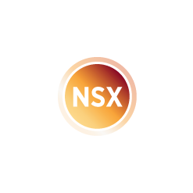

Cluster Configuration and AWS Availability Zones
AWS Region
Availability Zone
Availability Zone
Restricted to one AWS Region and AZ
Automatically detects failed hardware
Auto remediation HA allows automatic recovery from HA events
Provision new host and eject failed node without customer intervention
MGMT VMs
VM
VM
VM
VM
VM
VM
VM
vSphere Cluster
VSAN
vSphere
NSX
SDDC
AWS Global Infrastructure
Notes:
The default deployment installs the SDDC into a single Availability Zone (AZ). Remediation can happen within this AZ, however, if the AZ has an outage, the entire SDDC will be affected.
The enterprise level software, focused on infrastructure resiliency deals with outages, for example Auto Remediation HA resolves host and component failure.
Providing fast recovery of virtual machine and automatic replacement of host resources.

Slide 31
Stretch Cluster (Multi-AZ Deployment)
Multi AZ availability (Active-Active)
vSAN stretched across multiple AZs
Synchronous write replication across AZs
RPO = 0, RTO = HA Restart
Per-VM Storage Policy
First time infrastructure level AZ resilience! No need for refactoring traditional applications
AWS Region
VM
VM
VM
VM
VM
VM
VM
Availability Zone
Availability Zone
vSphere Cluster
vSAN Cluster
SDDC
AWS Global Infrastructure
Notes:
Remember when we first introduced vSphere HA. Instead of having to rebuild every application to make it high available, we could make every VM more resilient by selecting a few options at the infrastructure layer.
In VMware Cloud on AWS, customers now have the ability to choose a ‘Stretched Cluster’ deployment that spreads the infrastructure across two (2) Availability Zones. This brings an additional layer of availability to your workloads.
For the first time ever multi-AZ availability is possible by stretching the cluster across two AZs in the same region.
No need for refactoring traditional applications to obtain High availability on AWS Infrastructure.
Synchronous write replication is used across AZ’s. This results in a RPO of zero and the RTO depends on the HA restart.
If a host fails HA auto remediation solves this by replacing the host and rebuilding the vSAN datastore automatically.
This is truly ground breaking stuff, only possible by the partnership of VMware and AWS.

Slide 32
Cross AZ Traffic
vSAN Stretched Cluster – replication traffic
Traffic types
Read traffic serviced by AZ that VM resides on
Synchronous replication commits writes to both AZ’s
Witness traffic dependent on number of objects
Stretched Cluster
Read
Locality
Synchronous
Writes
Witness
AZ
AZ
AZ
Region
Notes:
Host Traffic:
With Stretched Clusters, read traffic is serviced by the site that the VM resides on. This concept is called Read Locality.
However all writes need to be syncrhously commited to both AZ in order for the data to be “protected”. To calculate the amount of traffic which would be sent for a given workload. Take the total amount of data (Wb) * data multiplier (md) : T = Wb * md
The data multiplier is comprised of overhead for vSAN metadata traffic and miscellaneous related operations. VMware recommends a data multiplier of 1.4 (40%)
Witness Traffic:
Depends on the number of components, but generally speaking every 1000 components will generate ~2Mbps of throughput.
$${Bandwidth}_{1000}= \frac{1,138 ∗ 1,000}{5s}$$
$$= 1. 82 Mbps+10\% safety margin=2 Mbps$$

Slide 33
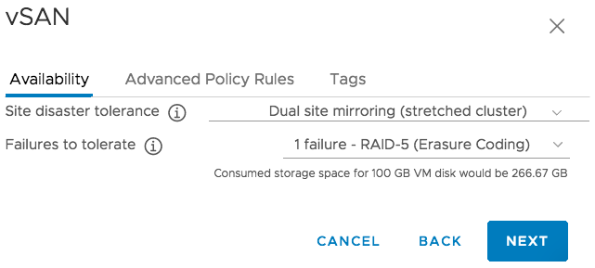
Policy Based Availability Management
Site and local data management in a single view
Site Affinity
Controls which sites should contain a copy of the data.
Local Protection
Controls how the data will be stored on each vSAN host.
Notes:
Key Message/Talk track:
When managing a vSAN Stretched Cluster a simple way to think about the vSAN policy is that the Site Disaster Tolerance controls which sites should contain a copy data. In the case of the dual site mirroring policy the data is synchronously written to both sites in the stretched cluster. However, for workloads which don’t require that level of availably we can also specify which site the data should be placed in.
The Failures to tolerate setting controls how many failures vSAN should protect itself from as well as the data protection methodology to be used locally within each site.
----------------------------------

Slide 34
Policy based data placement
Site Disaster Tolerance
Dual Site Mirroring
None – Keep data on Preferred
None – Keep data on non-preferred
All Data is mirrored to both sites in the cluster.
All Data is kept on the preferred site
All Data is kept on the non-preferred site.
Stretched Cluster
Stretched Cluster
Stretched Cluster
Data
Data
W
Data
Data
AZ
AZ
AZ
AZ
AZ
AZ
AZ
AZ
AZ
Region
Region
Region
Notes:
Key Message/Talk track:
Not all data stored on a stretched cluster needs to be replicated in-between AZ’s. Through SPBM we can configure to either mirror the in-between data sites, thus making the workload able to survive an AZ failure. Or we can set which side of the stretched cluster we would like to store the data for workloads which do not require enhanced availability.
----------------------------------
Overview:
Four Site Disaster Tolerance Configurations:
None – Standard Cluster: Data is stored wherever free space is to be found. Will not take fault-domains into consideration when placing components.
Dual Site Mirror: All data is mirrored across two fault domains with a witness object being stored on the witness hosts.
None – Keep data on preferred: All data is stored on the preferred site.
None – Keep data on Non-preferred: All data is stored on the Non-preferred site.

Slide 35
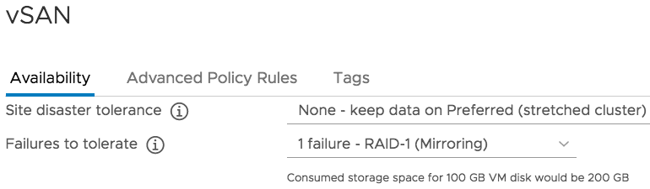
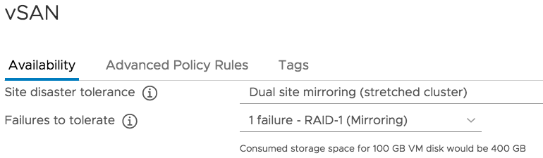
Provide Workload Resiliency Against AZ Failure
OS/APP
Stretched Cluster
Preferred Fault Domain
Non-Preferred Fault Domain
Witness
Data
W
Data
Data
Data
W
W
AZ
AZ
AZ
Region
Region
Notes:
Key Message/Talk track:
To visualize how we can manage data placement and availability within a vSAN stretched cluster using storage policy based management we will walk through a simple example.
Here we have a sample VM configured to the OS/App SBPM Policy, which is configured to keep all data on the preferred site only. We can also see that we’ve told vSAN to ensure the data can survive a single failure using it’s raid-1 mirroring based data protection system.
To configure this VM to survive a total failure of the primary site we simply change the policy to Dual Site Mirroring. (CLICK)
Notice how the VM falls out of compliance? This is because the data no longer complied to the stated desire of the policy. Once vSAN notices this it instantly get’s to work correcting the problem (CLICK)
In this case it simply copies the data to the non-preferred site. Once the data is replicated a cross site witness component is created on the witness host to protect against split-brain, and the data is now in compliance with the desire of the administrator and the policy is back in compliance.
The advantage of using a mirroring based policy is of course our ability to withstand the loss of an entire Amazon availability zone. We could even lose an additional host in the secondary site without impacting our workloads availability and or performance. The tradeoff made to enable this powerful capability being that in this case we’re consuming 400GB of physical capacity for every 100GB of data stored. With a cluster of at least 8 total nodes ( 4 per site ) we can combat this by using a more efficient Failure to Tolerate policy setting (next slide)

Slide 36
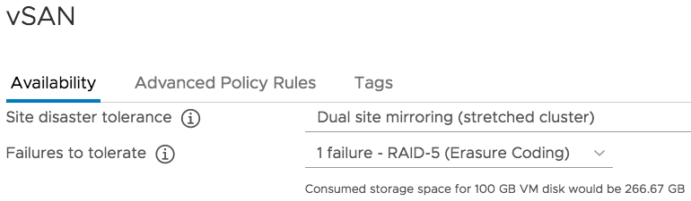
Provide Workload Resiliency Against AZ Failure
OS/APP
Stretched Cluster
Preferred Fault Domain
Non-Preferred Fault Domain
Witness
Data
W
Data
Data
Data
W
W
D1
D2
D3
P1
D1
P1
D3
D2
AZ
AZ
AZ
Region
Region
Notes:
Key Message/Talk track:
Just as before our VM’s policy quickly falls out of compliance and just as before vSAN get’s to work correcting the problem. However unlike last time we need to actually change how the data is being stored. Which means that in order to make this transition vSAN will need sufficient capacity to store all the objects assigned to our policy using both policy settings. Notice how the raid-1 data stipes stay in place while vSAN rebuilds the datasets using the more efficient Raid-5 Erasure Coding stripes. (CLICK)
Once the data has been stored using the new policy configuration we saw that vSAN removed the old RAID-1 data stripes and subsequently the policy was returned to full compliance.
The Advantage of this configuration is that we maintain the same survivability but at significantly less physical capacity. In fact we’re saving 150% by using an erasure coding policy. The trade off made in this instance is that we are accepting a slight performance hit in the event of our worse case failure since vSAN would be reconstructing any missing data from parity. At the end of the day policy based management enables the customer administrator to align data placement with the needs of the application using the simple declarative control plane of SPBM.

Slide 37
Relentless Availability with Stretched Cluster and AWS
Host Failure
Host fails, or problem identified
New host added to cluster
Data from problem host rebuilt, and/or migrated
Previous host evacuated from cluster, fully replaced by new host
Stretched Cluster
Witness
AZ
AZ
AZ
Region
Notes:
Key Message/Talk track:
Regardless of how the failure is detected the remediation follows a consistent path that take full advantage of the elasticity of the Amazon Cloud. In the case of a host failure inside a given AZ. Our standard host remediation system will simply lifecycle a replacement host into the cluster. No virtual machines need be moved with the exception where the only remaining copy of the data resides in other site.
----------------------------------
Overview:
Host fails, or problem identified
New host added to cluster.
Data from problem host rebuilt, and/or migrated
Previous host evacuated from cluster, fully replaced by new host

Slide 38
Relentless Availability with Stretched Cluster and AWS
Witness Failure
Witness Host fails, or problem identified
New Witness is provisioned in to cluster
Cross site witness components recreated on new witness.
Previous host evacuated from cluster, fully replaced by new witness host
Stretched Cluster
Witness
AZ
AZ
AZ
Region
Notes:
Key Message/Talk track:
In the case of a witness failure, all VMs will remain running in place. The automated support system will deploy a new witness appliance into the cluster. Once the healthy witness is available, vSAN will rebuild any missing cross-site witness components.
It’s important to point out that while the witness appliance is down the cluster has lost a vote. The two remaining fault-domains are using each other to form quorum and keep the workload running. As a result, if there were an AZ failure while the witness was down the cluster would not have sufficient votes to maintain quorum and would proactively shut down all VM’s to protect against a split-brain scenario. In this incredibly unlikely scenario, the cluster will restart any impacted VM’s as soon as either the hosts from the impacted AZ or witness return.
----------------------------------
Overview:
Witness fails, or problem identified.
New Witness is provisioned in to cluster.
Cross site witness components recreated on new witness.
Previous witness evacuated from cluster, fully replaced by new witness.

Slide 39
Relentless Availability with Stretched Cluster and AWS
AZ Failure
Site failure occurs
vSphere HA restarts affected VMs
Stretched Cluster
Witness
AZ
AZ
AZ
Region
Notes:
Key Message/Talk track: (Animated Version)
In the event of a complete AZ failure(CLICK) vSphere HA will detect and restart the workload as normal. (CLICK)
Once the AZ is brought back online vSAN will intelligently resynchronize any changes that may have occurred while the site was down. (next slide)
Notes:
HA attempts to failover VMs to other hosts in the same AZ
Service prefers to remediate host in AZ with host failure
vSphere HA restarts Management VMs (VC, NSX, etc.) and customer VMs in surviving AZ
Auto-remediation attempts to start hosts in the failed AZ. If that fails, SRE manually remediates hosts in the failed AZ when the AZ is back.

Slide 40
Relentless Availability with Stretched Cluster and AWS
AZ Failure
Site failure occurs
vSphere HA restarts affected VMs
AZ restored; Data resynchronized
Locality restored manually*
Stretched Cluster
Witness
AZ
AZ
AZ
Region
Notes:
Key Message/Talk track:(Animated Version)
If needed DRS will move the workload back to the original site/AZ. (CLICK)

Slide 41
Network Configuration

Slide 42
Networking in VMware Cloud on AWS
All VM networking in VMware Cloud on AWS is provided by NSX
Provides compatibility with NSX and vSphere products used on-premises
vSphere and NSX have been optimized to work in AWS environment
Delivered using an ‘as a service’ cloud model
Notes:
Simply put, networking in VMC doesn’t work without NSX.
It connects the ESXi host and abstract AWS VPC networks
NSX allows ease of management by providing logical networks to VMs.
When the cluster is scaled-out, NSX automatically connects the new hosts to the logical networks and the VMkernel networks.
The NSX version used in VMC provides compatibility with NSX and other vSphere products used on-prem, such as vMotion

Slide 43
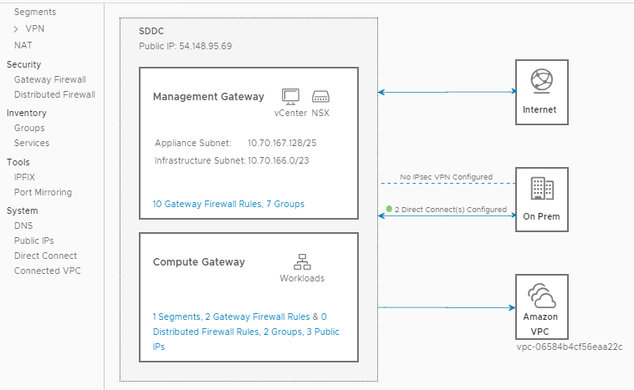
Rich Hybrid Networking and Connectivity Capabilities
NSX-T Provides:
Firewall
VPN
Micro segmentation
IPFIX
Port Mirroring
And more…
Direct Connect
VPC Connectivity
Notes:
NSX-T SDDC’s bring a much richer set of features to VMware Cloud on AWS. Unlike the previous SDDC’s that were deployed with NSX-V, NSX-T allows customers to do things such as Micro segmentation, IPFIX, and Port Mirroring.
NSX-T architecture also simplifies the connectivity to remote sites, where in previous SDDC’s, two VPNs would be required (one to Management and one to Compute Gateway), Now, only 1 VPN is required and allows access to both sides.

Slide 44
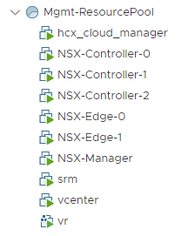
NSX Implementation Details
NSX components deployed into the Management resource pool
Controllers and NSX Manager
Management Gateway (MGW) = NSX Edge for Management components
Compute Gateway (CGW) = NSX Edge and DLR for customer VMs
Default configuration
Firewall Rules are set to Default Deny
NSX Edge High Availability is enabled
NSX Edges are size Large by default
A default logical network with SNAT and DHCP enabled is provisioned for compute
Notes:
NSX is deployed with an NSX Controller on each host, which is VMware Best Practice, and with two NSX Edges for high availability.

Slide 45
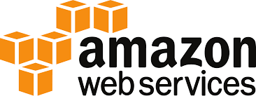










Connected VPC Access to VMware Cloud on AWS Management
NSX-V AWS Connected VPC
NSX-T AWS Connected VPC
VMware Cloud on AWS
VMware Cloud on AWS
VPC Endpoints
Internet GW
VPC Endpoints
CGW
192.168.10.0/24
VPC Router
Internet GW
CGW
192.168.10.0/24
Amazon S3
DLR
Amazon S3
VPC Connectivity through
ENI
192.168.20.0/24
VPC Connectivity through
ENI
192.168.20.0/24
NSX Overlay
Network
192.168.30.0/24
NSX Overlay
Network
192.168.30.0/24
VPC Router
VPC Router
Router
MGW
MGW
Mgmt.
Appliance
Mgmt.
Appliance
EC2 Instances
192.168.10.0
EC2 Instances
192.168.10.0
EC2 Instances
EC2 Instances
VPC subnets
192.168.20.0
VPC subnets
192.168.20.0
192.168.30.0
192.168.30.0
VPC route table
ESX VMKernel
VPC route table
ESX VMKernel
10.20.0.0/16
10.30.0.0/16
Availability Zone 1
10.20.0.0/16
10.30.0.0/16
Availability Zone 1
Customer VPC
VMware Cloud on AWS SDDC
Customer VPC
VMware Cloud on AWS SDDC
Notes:
In older NSX-V SDDCs, the AWS VPC was connected specifically to the Compute Gateway. However with NSX-T, the VPC is now connected to both the Compute Gateway and Management Gateway.

Slide 46




Direct Connect Configuration: Private VIF Example
interface gi0/0.100
VLAN 100
IP 168.254.254.14/30
BGP AS 65502
MD5 Key
dxvif-aabbccdd
VLAN 100
IP 168.254.254.13/30
BGP AS 64512
MD5 Key
eBGP
Entire VPC CIDR advertised
VMC on AWS
Management Traffic
AWS Backbone
Network
Customer
Network
Mgmt Appliance Network NSX Network Segments
CGW
10.3.10.0/24
DX Location
10.3.20.0/24
Compute Traffic
On-prem Network
VGW
NSX Overlay
Network
10.3.30.0/24
Private VIF
Customer
Router
AWS DX
Router
MGW
Mgmt.
Appliance
VLAN 10
VLAN 20
10.10.0.0/16
10.30.0.0/16
Customer DC
VMware Cloud on AWS SDDC
Notes:
When configuring Direct Connect, there are two different methods of connecting DX to your VMware Cloud on AWS instance.
Private Virtual Interface (ViF): Private ViF terminates directly in the customer VPC. No VPN is required for on-prem resources to communicate with VMware Cloud resources. External BGP (eBGP) allows for route advertisements between different networking hardware. This allows, for example, the on-prem network to advertise specific subnets and routes for VMC traffic to use. Public Virtual Interface: The Public ViF terminates inside of AWS datacenters but not directly into the customer VPC. This means that the customer will still need to leverage a VPN connection across the DX line to communicate with VMC resources

Slide 47
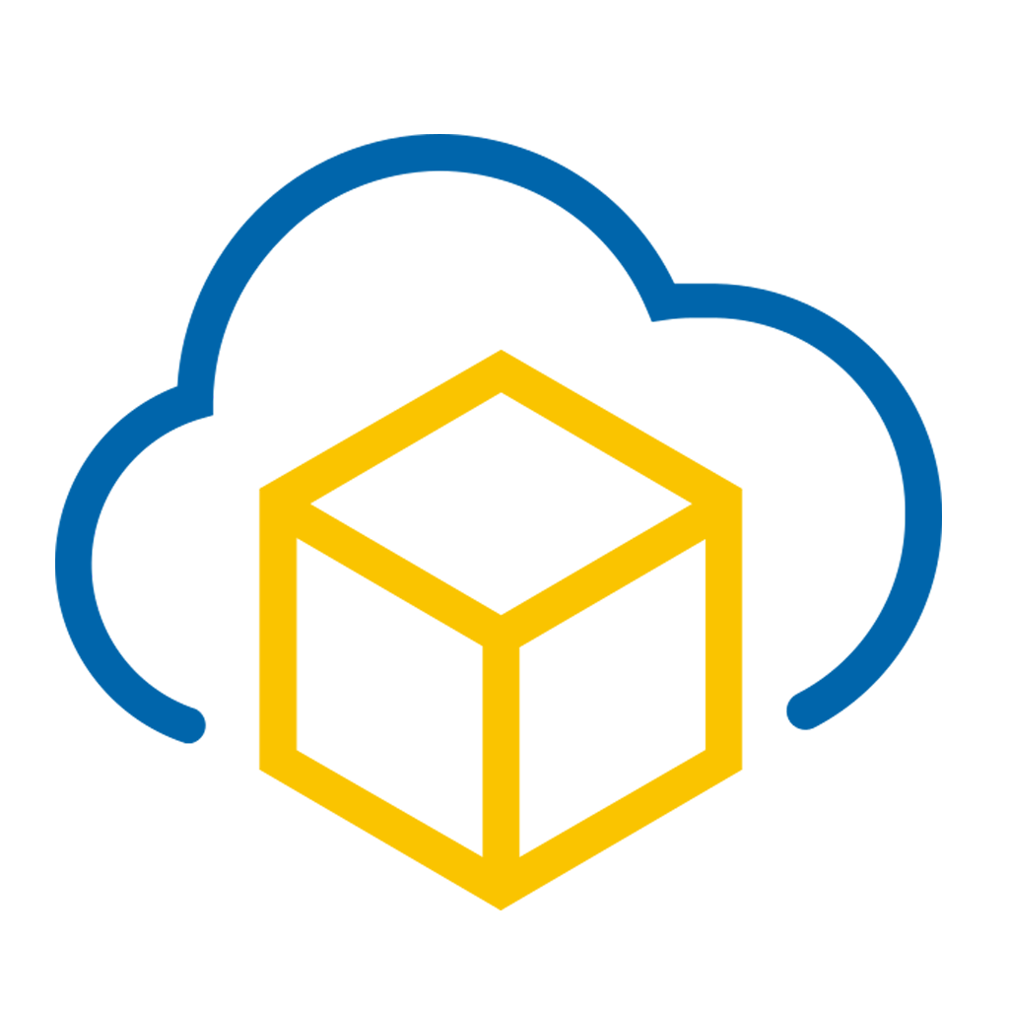


Direct Connect Topology
Management Components
Customer
Network
DX Location
AWS Backbone
Network
IGW
CGW
Customer
Router
DLR
192.168.10.0/24
Workload Traffic
Over Private VIF
NSX Overlay
Network
192.168.20.0/24
Compute Resources
On-premises Network
VGW
VPC Router
Private VIF
MGW
Mgmt.
Appliance
vMotion,
ESX Management,
Mgmt. Appliances Traffic
Over Private VIF
VLAN 10
AWS DX
Router
ESX VMKernel
10.10.0.0/16
VLAN 20
VMC SDDC
10.20.0.0/16
Customer DC
Notes:
All traffic can flow over Direct Connect between on-prem and VMC resources. There is no need for additional network connectivity unless desired.

Slide 48
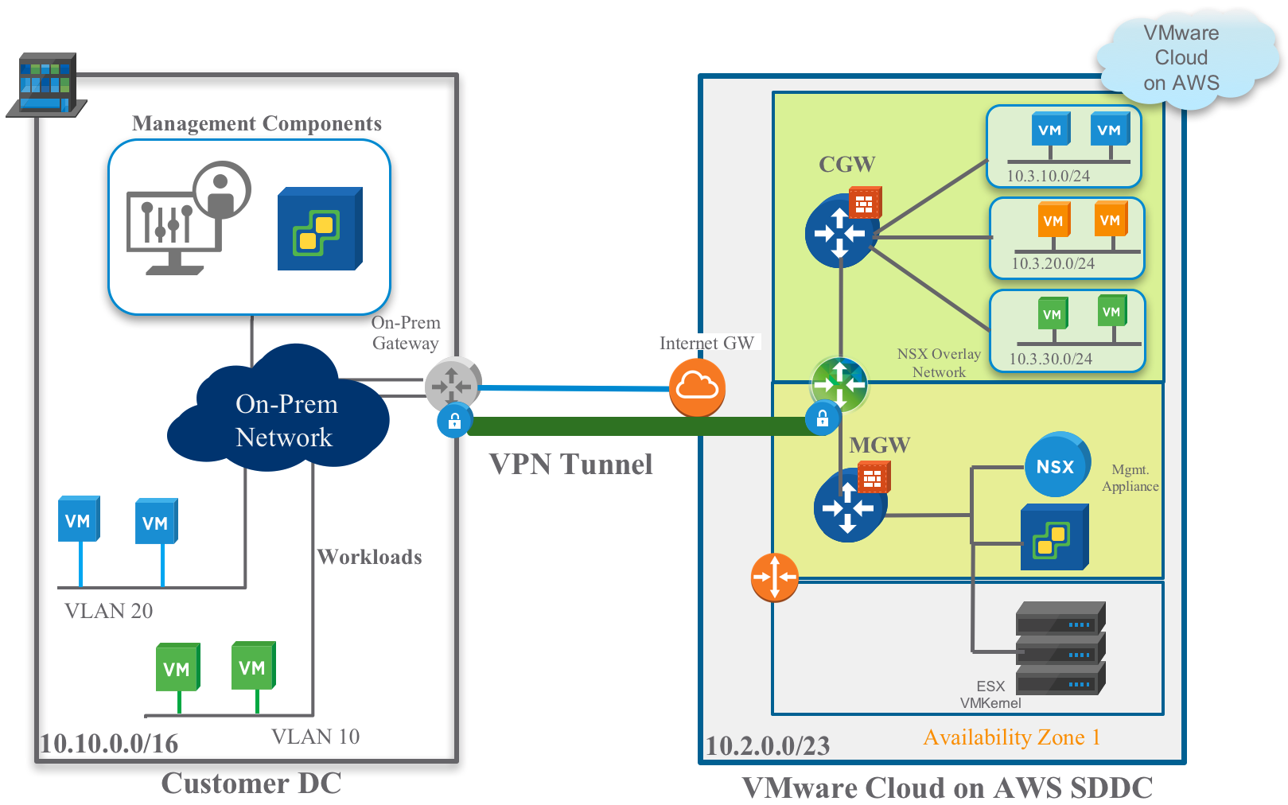
IPSEC VPN Enhancements
Notes:
In VMware Cloud on AWS, an IPSEC Layer-3 VPN tunnel can be established between the on-prem resources and the VMware Cloud resources. Firewall rules and subnet advertisement allow customers to choose which subnets are visible and routable across this connection.

Slide 49
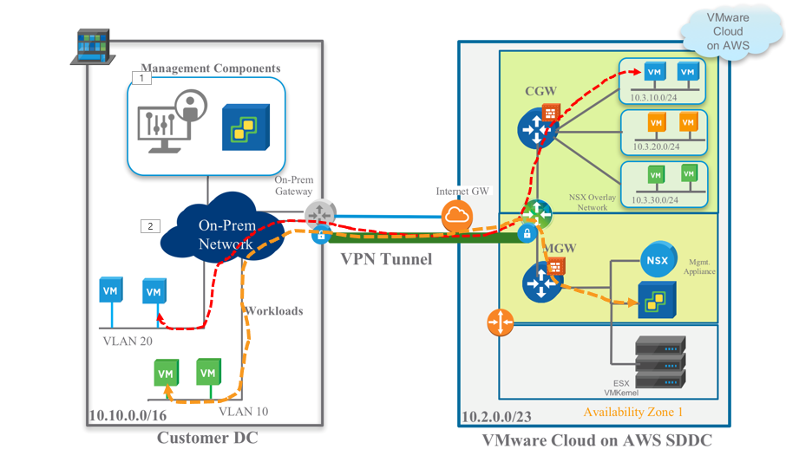
Route Based IPSEC VPN
Advantages:
Provides Redundancy – Setup VPN tunnels to two different on-Prem edge devices
Active/Passive design possible
Networks automatically learned from VMware Cloud on AWS SDDC and on-Prem
No additional configuration required when advertising new networks

Slide 50
How Do You Get Your Workload in the Cloud SDDC?

Slide 51
vCenter Content Library
Automatically synchronize user-content across cloud instances
Distribute your content effortlessly
OVA
ISO Images
Scripts
Templates
SUBSCRIBER
VMC SDDC
ON-PREM
SDDC
SUBSCRIBER
VMC SDDC
Notes:
vCenter content library is the perfect feature to keep the availability of OVA, ISO Images and scripts in sync between on-prem and in-cloud SDDC deployments.
Template support will be added in future release. Moving to a content library as soon as possible is an excellent exercise for customers waiting on the initial availability of VMC.
By adopting content library they are ready to use VMC to its full potential from day one.

Slide 52
Hybrid Cloud Operations
Confidential
Single pane of glass for Hybrid Cloud Management
Hybrid Linked Mode provides operational consistency
On-Premises vCenter connects to SDDC vCenters
Cold Migration and vMotion from the UI
Per-VM EVC support for Cross-Cloud vMotion
Notes:
VMC is designed to provide you a single pane of glass for Hybrid Cloud management.
Hybrid Linked Mode is a new feature that allows operational consistency between vSphere environments on-prem and in-cloud.
Per-VM EVC provides proper vMotion compatibility between the in-cloud ESXi hosts CPU architecture and the customer on-prem ESXi hosts CPU architecture, rather than requiring the entire cluster to run at a Least Common Denominator in terms of CPU Architecture, this can be enabled per VM.

Slide 53
vCenter Hybrid Linked Mode
Confidential
In-Cloud SDDC vCenter VCSA 6.5+
Embedded PSC + DB
One vSphere SSO domain allowed to join VMC (multiple vCenters can be a member of on-premises SSO)
On-premises embedded or external PSC supported
On-premises vCenter 6.0 Update 3 - or later - required
Notes:
vCenter Hybrid Linked Mode allows linking vCenters running across different SSO domains, different versions, and different topologies.
HLM supports both embedded or external deployments on-prem.
vCenter HLM allows the on-prem and Cloud vCenters to share data while maintaining some level of administrative separation.
HLM will be restricted to connecting one on-prem enhanced Linked Mode Domain. Due to the restricted access model in VMC, the roles will not be synchronized in HLM.

Slide 54
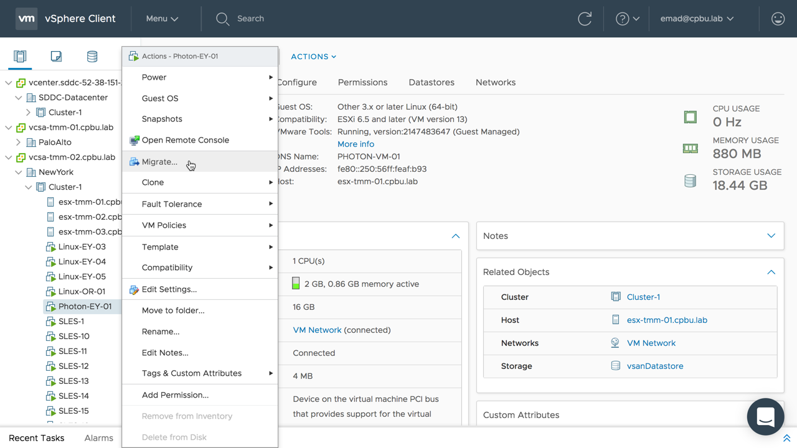
vMotion is here!
vMotion VMs from on-prem to SDDC and back over L2VPN
No need to power off the VM
No need to re-IP address of the VM
Requires 250Mbps of bandwidth per vMotion
Disclaimer: *Preview – feature for a subset of customers to test and provide feedback. Not guaranteed to move to available phase”
Notes:
If customers are using either Direct Connect or IPSec VPN, and using a Layer-2 Stretch network, workloads can then be vMotioned between on-prem and the cloud (and vice versa) with ZERO downtime. There is no need to re-IP the workloads because of the Layer-2 Stretched network. The VMs do not need to be powercycled either. However, vMotion requires a minimum of 250 Mbps per vMotion

Slide 55
Workload Migration Options
L3 IPSEC VPN = Cold Migration
L2 VPN = Live Migration (Long-Distance vMotion caveats apply)
AWS Direct Connect (Live Migration)
Notes:
Workloads can be migrated to the cloud in several different ways:
IPSec VPN: by itself, Cold Migrations can occur
L2 VPN: Allows customers to perform Long-Distance vMotions
AWS Direct Connect allows for Cold Migration as well as vMotions (as long as the L2VPN is present as well)

Slide 56

Migrate 1000s of VM live with new feature of HCX
Accelerated Cloud Adoption And Migration With HCX, App Mobility and Hybridity Services
App Mobility between any vSphere versions across on-premises and VMware Cloud on AWS
Best-In-Class migration, VMware Cloud Motion with vSphere Replication with zero downtime
Secure, Bi-Directional, Traffic Engineered, Network Extension with Auto VPN set up
HCX
App Mobility
Infrastructure Hybridity
vSphere
vSphere
Infrastructure Abstraction
USE CASES
DC Evacuation
DC Consolidation
Hardware Refresh
DC Extension
vSphere
On-Prem
VMware Cloud on AWS
Internet / Direct Connect/WAN
Best-In-Class Cloud Migration With VMware Cloud Motion
Notes:
HCX is an additional tool included with VMware Cloud on AWS. This tool allows customers to:
Perform bulk migrations between on-prem resources and VMware Cloud resources
Built-in VPN and Layer2 stretch
WAN Optimization and Compression
VMware Tools and VM Compatibility version upgrades
And more…

Slide 57
AWS VPC Setup

Slide 58
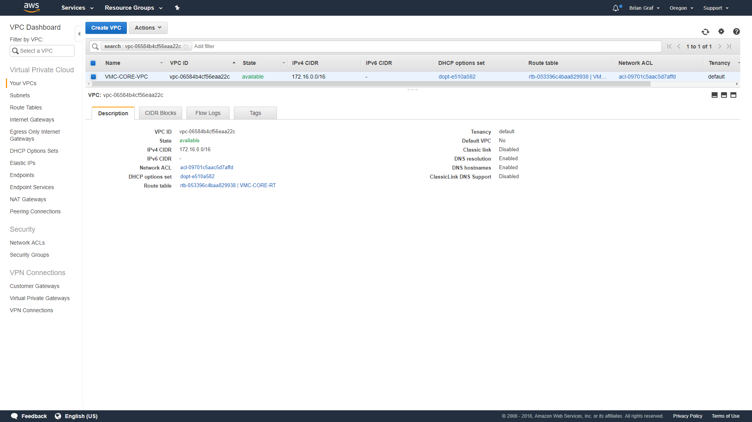
VPC Creation
AWS VPC REQUIRED IN REGION WHERE THE SDDC WILL BE DEPLOYED
Notes:
To attach an SDDC to a VPC, Create a VPC in the AWS console in the region where your SDDC will be deployed.

Slide 59
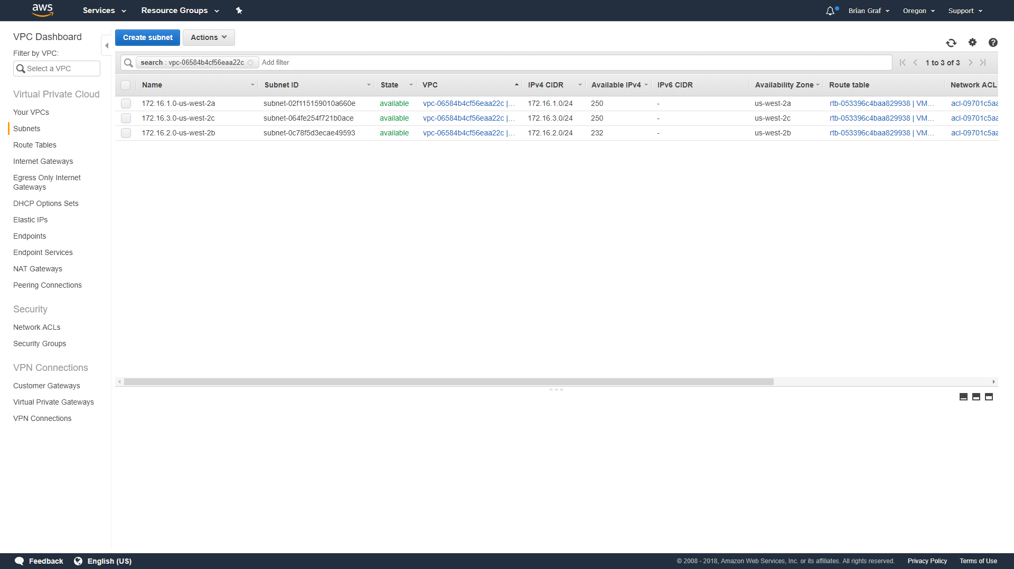
VPC Creation
Subnet / AZ Considerations
Planning ahead for SDDC placement can save $$ on cross-AZ data charges
SDDC can integrate with native AWS services, deploy SDDC to same region and AZ as current services being utilized
SDDC deploys to single AZ by default unless deploying a multi-AZ (stretched cluster)
Notes:
Ensure that a subnet is created for the Availability Zone (AZ) that the SDDC will be deployed to

Slide 60
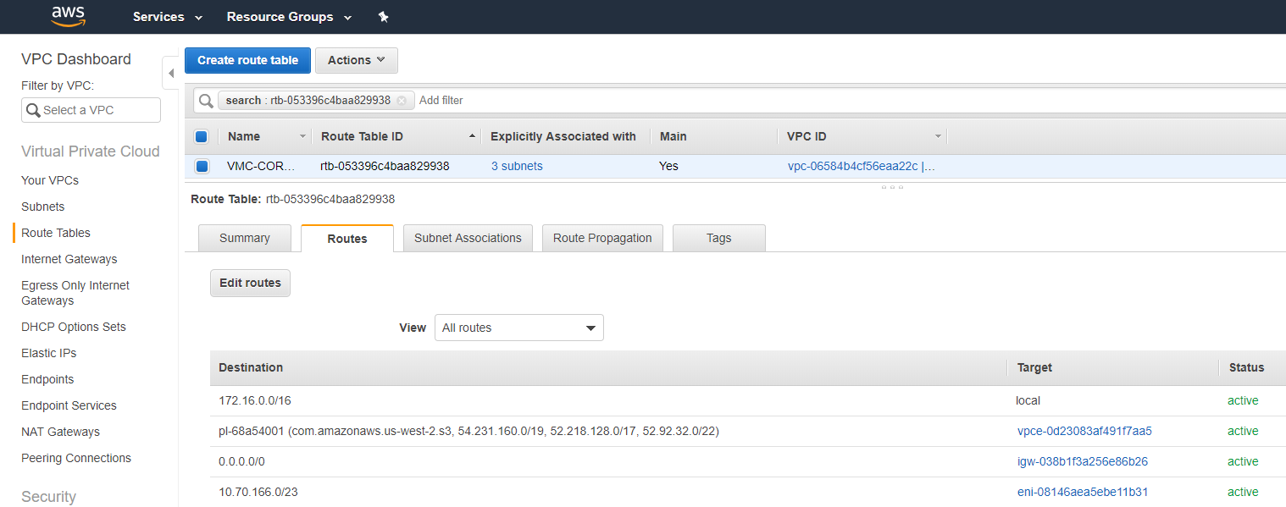
VPC Creation
Automated Route Tables
When users create new logical networks within vCenter, the subnets auto-populate in the VPC route table
Routes into VMware environment use the ESXi Host ENI of the active NSX Edge
Notes:
When a user creates a new Segment (logical network) in NSX, the connected VPC route table will automatically be updated to add the segment for easier routing administration.

Slide 61
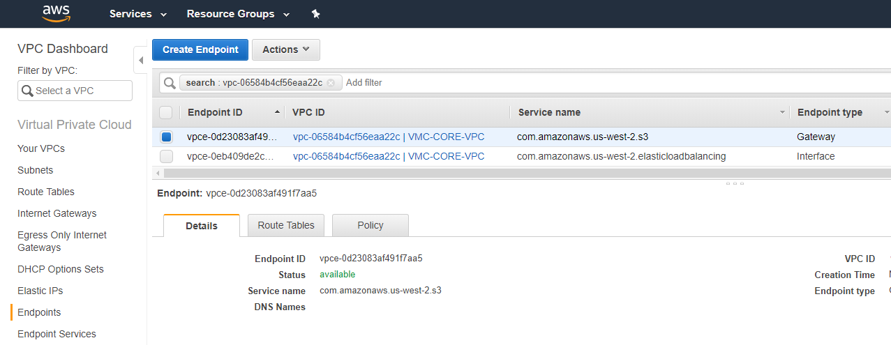
VPC Creation
Leverage AWS Endpoints
Using the AWS S3 Gateway will allow all S3 traffic to flow through the ENI rather through the Internet Gateway (incurring egress data charges)
ENI – High bandwidth, low latency connection
Notes:
By adding an S3 endpoint into the VPC, the S3 data traffic will flow across the Elastic Network Interface that is connected to the ESXi Hosts, allowing you to bypass S3 egress charges when being accessed from within VMC.

Slide 62
Administration

Slide 63
VMware Cloud on AWS is a service
Overview
The fully configured VMware Cloud software stack will be provisioned, operated, and maintained directly by VMware.
Provisioning
Automated account creation and environment provisioning by using the API
Automated interconnection created between VMware and AWS customer accounts
Operations
Support provided by VMware directly
AWS infrastructure (for VMware Cloud on AWS) support managed by VMware
Ongoing infrastructure monitoring
Maintenance
Ongoing stack maintenance managed directly by VMware
Upgrade implementation and execution
Notes:
VMware Cloud on AWS is a service that is offered to our customers. The service allows customers to deploy a Software-Defined Datacenter (SDDC). VMware maintains the operational support (patching/upgrades/support/monitoring/etc) and manages the entire infrastructure. The customer works directly with VMware and does not need to be managed by the customer. The customer is able to focus on consuming the resources rather than being an administrator for it.

Slide 64
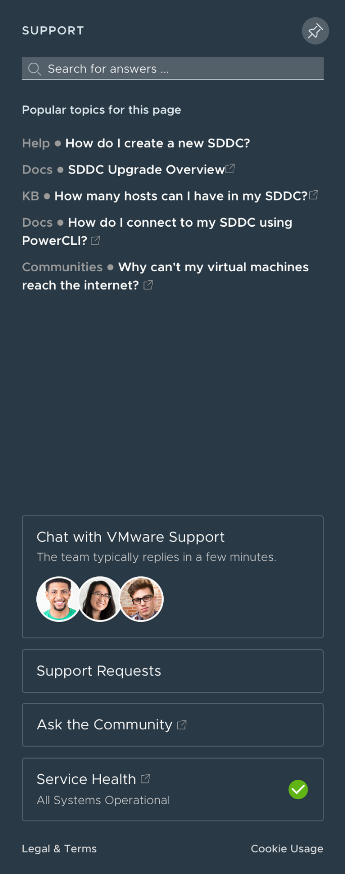
VMware In-Product Support Experience
Intelligent Search: Surfaces popular content based on the user’s location and contextual usage in the product
Chat with VMware Support: Quickly address questions or issues with highly skilled VMware Support Engineers and Customer Support Representatives
Support Requests (SRs): Create and manage SRs or our Support Engineers can create SRs on their behalf via chat without leaving the product.
Ask the Community: Engage and pose questions to actively moderated communities backed by passionate VMware Support Engineers and VMware Experts around the globe.
Service Health: Review live status of VMware Cloud Services and receive important service notifications.
Notes:
The support tab within the VMware Cloud on AWS console provides intelligent support to the customer based on the page or resource the customer is currently viewing. This helps to easily weed out unrelated support items and brings efficiency and speed to customer resolution times.
Customers are able to open a direct chat with VMware support from within the browser. Upon clicking on the chat, customers will be connected with a support agent that can help them with their needs
Support Requests can be created and managed from the tab as well. An easy to see and use ‘Service Health’ link exists so that customers can verify the health of the service.

Slide 65
VMware Cloud on AWS: Account Structure
VMware Cloud VPC account
A new AWS solution account is created for each customer
Is owned, operated, and paid directly by VMware
Each solution account is single tenant for all ESXi hosts
Solution account is linked to a VMware Master-Payer account
AWS customer VPC account
Is owned, operated, and paid directly by the customer
VMware Cloud endpoints are automatically deployed into the customer VPC with customer consent
Has full access to VMware Cloud endpoints within the VPC
Has full access to the entire catalog of native AWS services within the AWS Region of deployment
Notes:
Two VPC accounts are used when deploying an SDDC. The VMware Cloud on AWS SDDC is deployed into a VMware Cloud VPC account. This is a brand new account created for the customer, managed and run by VMware. VMware also pays for this solution. Each account is single-tenant for all ESXi hosts.
When the SDDC is deployed, it is linked to a customer VPC account, which allows customers to be able to integrate AWS services and workloads natively with their VMware workloads and infrastructure.

Slide 66



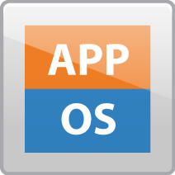





Customer Data Center
AWS Direct Connect
VMware Cloud VPC
AWS region A
Customer VPC
free
AZ1
$0.02/GB
vCenter
Compute
Network
Storage
Cross-AZ $0.01/GB
ESXi
vSphere
NSX
vSAN
Internet
free
ENI @25Gbps
vSphere Environment
Cross-AZ $0.01/GB
free
AZ2
$0.05/GB
free
free
Cross-Region $0.02/GB
free
S3 Public end-point
$0.09/GB
free
Color coding
Paid by VMware – Charged back to Customer
Paid by Customer to AWS directly
free
S3 in region A
AWS region B
free
Notes:
Here you can see an easy to use reference chart of how egress, cross-AZ, and cross-region traffic charges are handled. All data into (ingress) VMware Cloud on AWS is free. Just like regular AWS services, any cross-AZ traffic costs $0.01/GB. Cross region traffic costs $0.02/GB, and Egress traffic from VMware Cloud on AWS out to the internet or back to the on-premises environment is $0.05/GB.

Slide 67
VMware Cloud on AWS: Access model
VMware Cloud on AWS is delivered ‘As a Service’ with the following operational model:
AWS manages the physical resources
VMware manages the hypervisor and management components (includes monitoring, patching, upgrades, etc.)
Customer manages their VMs (and networks)
Customer access is via vCenter and VMware Cloud on AWS portal with some restrictions
No root ESXi access
No vSphere Distributed Switch (VDS) configuration access
No direct management of VM/NSX Edge access
Limited permissions in vCenter Server
Notes:
Because VMware Cloud on AWS is a service offering, there are a few changes to what parts of the environment each customer has access to. Because we (VMware) take care of upgrades, support, maintenance, etc., VMware maintains the root access to the hosts, Customers have read-only abilities into most resources, but without the ability to manage or configure Distributed Switches (this is fine because all functionality is handled in NSX in the VMC Console), no direct management access to the NSX Edge appliances, and no ability to install third-party VIBs on the ESXi Hosts.

Slide 68
vCenter – Permissions
Guiding principles
VMware retains control of all management and infrastructure components
All else consistent with standard vCenter
YES
NO
VM operations, vApp
Customer Resource Pool
Customer Datastore*
Network* (logical networks)
SPBM
Content Library
Tagging
Folder, System, Alarm*
Host
Datacenter
Mgmt Datastore
Network (physical)
Cluster
Notes:
Customers have access and control over items in the YES column
VMware retains control of everything in the ‘NO’ column

Slide 69
Orgs (Organizations)
Flexible Container for:
Authentication (including federation)
Authorization (OrgOwners control RBAC for OrgMembers)
Service access and subscriptions
Simply put:
A user can be a member of one or more Orgs
A user can have different roles in different Orgs
An Org can be associated with one or more services
A user can have different roles for different services within an Org
User Experience
Users work in the context of a single Org – has switcher built in
Notes:
Each org is a logical construct maintained for groups of individuals and for billing purposes. If a customer have more than one organization, the customer will have a unique oAuth token for each org.
Each org is handled and administrated separately than the others. Org Owners are able to invite other individuals to the organization and can give them permissions to use different VMware Cloud products.

Slide 70
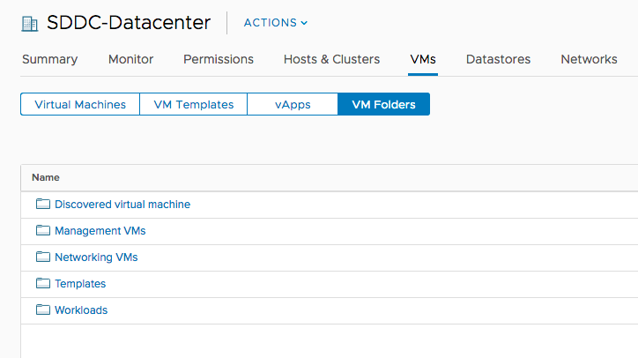
Default Folder Structure
Notes:
The default folder structure in vCenter includes:
‘Discovered virtual machine’
Management VMs
Networking VMs
Templates
Workloads
The Management and Networking folders are not available for customers to deploy workloads. Customers can deploy into ‘Templates’ or ‘Workloads’ folders. Customers can also add additional folders for use.

Slide 71
VMware Cloud on AWS Platform API Introduction

Slide 72
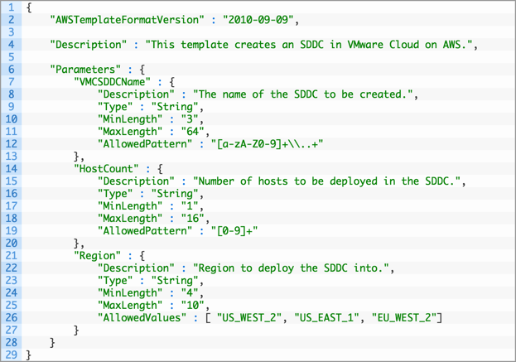
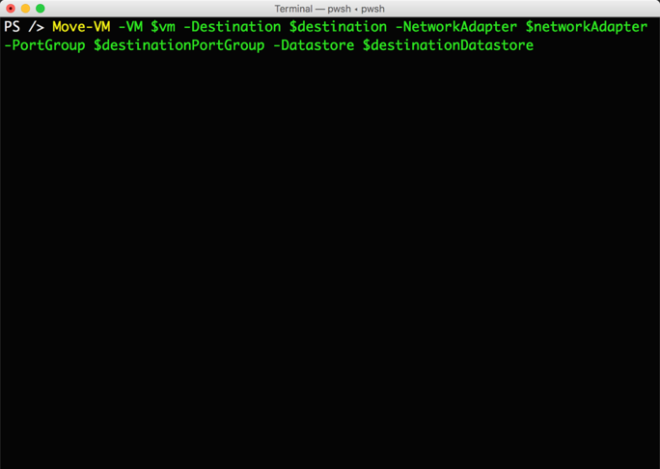
Automation
Not dependent on Hybrid Linked Mode
Move-VM Cmdlet
Across vCenters
Supports Multi NIC VMs
REST APIs
vSphere SDK support
Integrations
CloudFormation
Terraform
Developer Center
Notes:
The VMware Cloud on AWS APIs are RESTful based, making use of the modernized standards such as CRUD (Create, Retrieve, Update, Delete) based actions and utilizing JSON formatted inputs and outputs for the data structure. The documentation for these APIs are available in numerous ways both online, inline, and through the newly released Developer Center that will be covered in more depth shortly.
There are three main APIs, among several others, which users should be aware of that allow you to programmatically access the VMware Cloud on AWS features and surrounding areas to work with the environment and automate or develop to succeed in your use cases.
The Cloud Services Platform (CSP) APIs are available for all cloud services which are offered by VMware. They contain the core features that customers will use when working with multiple cloud services from VMware.
The VMware Cloud on AWS (VMC) API will be the endpoint for most actions available within the VMware Cloud on AWS console. This API allows for SDDC management actions like creating or removing SDDCs with a single API call, adding or removing the elastic hardware provided by the VMC service and adding the ESXi hosts to our SDDC, and handling network operations for the SDDC. We can also gather task based information on items which take place in the VMware Cloud on AWS environment.
The last of the APIs are the vSphere APIs. These are the same APIs you already know and love! You will be able to consume these APIs in the exact same way you already do with our on-premises offerings of vSphere. With VMware Cloud on AWS being a managed environment you will of course have limited permissions and certain key differences on areas which you should deploy to, but these are the same limitations that exist within the UI.
It’s worth noting that none of these depend on linking back to an on-premises environment, these are all standalone APIs. And because it’s vSphere at the heart of this service, all your PowerCLI scripts, SDK integrations, and so forth will work out of the box. Though, that restricted permissions model will be something to keep in mind.
There was discussion early about workload mobility, and PowerCLI’s Move-VM is absolutely supported as one of the methods to migrate those workloads from on-premises to VMware Cloud on AWS and back!

Slide 73
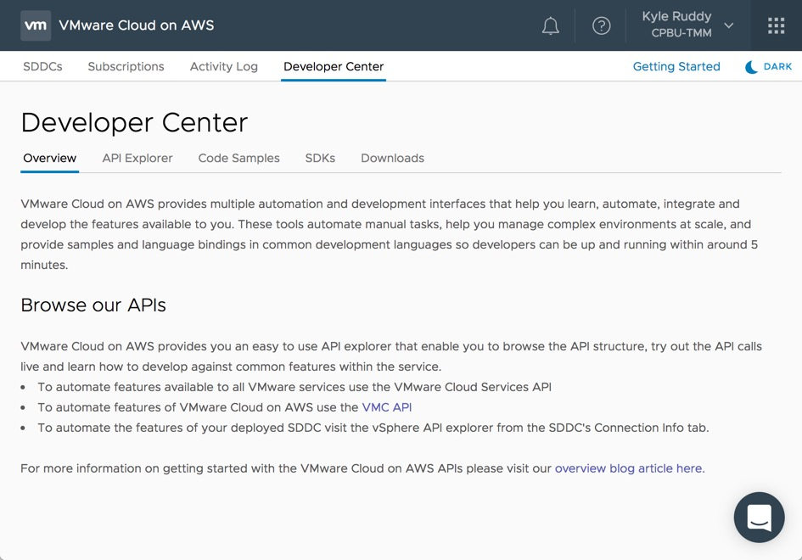
VMware Cloud on AWS Developer Center Overview
Available directly from the Cloud Console
Easily Access:
API Explorer
Community Code Samples
SDKs
Downloads
API Explorer
Automatically authenticates using current user’s OAuth token
Automatically populates certain fields
SDKs include links to their GitHub repo, documentation, samples, getting started blogs
Downloads include links to PowerCLI, Datacenter CLI (DCLI), and Terraform resources
Notes:
We have introduced a brand-new Developer Center. This area is a great resource allowing developers to get up and running quickly with VMware Cloud on AWS. Developers can gain access to this information front and center as a new tab in the VMware Cloud on AWS console! The VMware Cloud on AWS Developer Center consists of several sections, each with the goal of helping to make the development and automation experience and learning easier.
The API Explorer section brings easy access to interact directly with the RESTful APIs available from the Cloud Services API and the VMware Cloud on AWS (VMC) API. These APIs are presented by way of an interactive API browser with some very nice integrations making it easy to work with VMC. The API Explorer being internal to the Cloud console allows us to use the existing refresh token to authenticate. We can also automatically populate certain fields, such as the Organization ID, to help improve the experience of learning and using these APIs. Learning the API and seeing the responses from within the API Explorer could not be easier with the ability to “Execute” these APIs and see the live responses.
The next section is focused on code samples. These are curated directly from the samples written by both VMware and the community in a variety of formats. These samples could be written in Python, PowerShell, be a Postman collection or other integration code samples provided on the VMware Code Samples Exchange.
There is a wide variety of software development kits (SDKs) available to interact with the VMware Cloud on AWS APIs and the deployed SDDC products. The SDK section provides easy access to each of these open-sourced SDKs that are available on GitHub. There are also links to the documentation, samples, and even the ‘Getting Started’ blog post for each SDK!
The last section is called Downloads. This section is where there will be a wide variety of resources available. There will be command line resources like Datacenter CLI (DCLI) and PowerCLI. Also, there will be links to provisioning tool resources from Terraform and CloudFormation.

Slide 74
Infrastructure as Code
SDDC Automation with industry leading tools
Automate VMware Cloud on AWS SDDC-level provisioning with support for:
AWS CloudFormation templates
HashiCorp Terraform Modules
Enables single shot deployment of hybrid environments leveraging on-premises, VMware Cloud on AWS and AWS Services
Notes:
Another bit of big news was the addition of an Open Sourced Github repository to showcase VMware Cloud on AWS integrations written by both VMware and the community at large. The first of these integrations is the support for CloudFormation and Terraform integrations. These allow you to manage your SDDC as code!

Slide 75
VMware Cloud on AWS Platform API
VMware Cloud on AWS Exposes three API surfaces that work together to provide end-to-end functionality
Console
VMware Cloud on AWS
vCenter
All APIs adhere to modern API standards
RESTful
HTTP Verbs - GET, POST, DELETE, PATCH
JSON
Dictionaries with Key – Value pairs
OAuth
Authentication tokens as part of the HTTP Header
console.cloud.vmware.com
vmc.vmware.com
vcenter.{customer}.vmc.vmware.com
Notes:
VMware Cloud on AWS has 3 API surfaces which can be used to interact with VMware services.
Console.Cloud.VMware.com is primarily for authentication against our CSP (Cloud Services Platform)
Once you have your authentication, you can work with the vmc.vmware.com, which will allow you to do such things as:
Deploy SDDC
Add/Remove Hosts
VMC Networking Configuration
Add/Remove users from the organization
The vcenter.{customer}.vmc.vmare.com API surface is all of the regular vCenter APIs that you would be working with in your on-prem environment as well.

Slide 76
VMware Cloud on AWS API Endpoint
API Endpoint available for VMware Cloud on AWS features such as:
Create/Remove SDDC
Add/Remove Host
List Org Information
List SDDC Information
List VMware Cloud on AWS Tasks
Accessible via access tokens
Simple API model
API Explorer available
Command Line interface available
Base URL: http://vmc.vmware.com/vmc/api
VMware Cloud™ on AWS Powered by VMware Cloud Foundation
vCenter
vSphere
vSAN
NSX
ESXi on Dedicated Hardware
Support for VMs and Containers
vSAN on Flash and EBS Storage
Replication and DR Orchestration
NSX Spanning on-premises and Cloud
Advanced Networking & Security Services
AWS Global Infrastructure
AWS Global Infrastructure
AWS Global Infrastructure

Slide 77
THANK YOU!
Brian Graf
@vBrianGraf
Senior Technical Marketing Manager
VMware Cloud on AWS
Notes:
M2 technical Deck (12-2017)

